Slide 1
Microvariation in Sinitic nominalization (漢語方言名詞化的構造和參數)
Keith Tse (MCIL CL)
Ronin Institute/IGDORE (浪人學會/國際通行開放研究及教育學會)
Wu Dialects Colloquium
16th July 2021
My grateful acknowledgement to the audiences at previous conferences to whom earlier versions of my work on Chinese nominal constructions were presented, namely FoCaL-2 (Education University of Hong Kong, July 2019), Isoctal-3 (University of Cork, Ireland, December 2019) and 24th Yue Dialects International Conference (University of Macau, November 2020), and 9th Workshop on Nominalizations/9emes Journées d’Etude sur les Nominalisations (JENom9) (June 2021). Special thanks also to my supervisors and mentors in East Asian and Theoretical Linguistics, especially Professor Feng Sheng-Li (馮勝利), Professor George Tsoulas, Professor Giuseppe Longobardi, Professor Peter Sells, Professor Ian Roberts and Professor Edith Aldridge for helping me with the facts and theories. Thanks also to the organisers of the Wu dialect colloquium for accepting my abstract, despite the fact that I do not speak Wu dialects. I hope that you find the content of my presentation satisfactory.

Slide 2
Nominalisation in Chinese (漢語名詞化)
(Ad)nominalization (Yap et al (2011)):
Adnominaliser (結構助詞): de (的)/ ge (嘅/个) ([t-]/[g-])
Possession (cf English ‘s):
我 嘅 車 (我 架 車) (Cantonese)
ngo ge ce ngo ga ce
‘My car’ (Sio (2011:129))
我的車 (Mandarin)
wo de che
‘My car’
Attribution:
胖 的 女人 (Mandarin)
pang de nüren
‘fat woman’
肥 嘅 女 人 (Cantonese)
pang ge neoi jan
‘fat woman’ (Sio (2011:129))
Different functional heads in nominal domain (Paul (2019))
的 < 底 < 者 (phrase-final nominaliser: XP-n) (劉 2008; Aldridge 2009);個 (general classifier) (CL) (曹 1995; 李 2016)

Slide 3
Nominalisation in Chinese dialects: microvariation (漢語名詞化的參數)
de (的) ≠ ge (嘅）: VdeO/*VgeO
Adnominaliser (結構助詞): de (的) vs ge (嘅)
Tang (2011)/鄧 2008; 2009; 2010: North vs South (南北非是) (鄧 2009:243)
Chinese cleft constructions (是-的/係-嘅: COP + de/ge):
佢 係 琴日 買 非 嘅 (Cantonese)
Keoi hai kamjat maai fei ge
他是昨天買票的 (Mandarin)
ta shi zuotian mai piao de
‘It was yesterday that he bought tickets.’
*佢 係 琴日 買-嘅 非 (Cantonese)
keui hai kamjat maai ge fei
他 是 昨天 買-的 票 (Mandarin)
ta shi zuotian mai-de piao
‘It was yesterday that he bought tickets.’
Sentence-final de/ge (SFP) expresses all TAM values, whereas verbal suffix de (VdeO) expresses past tense (Simpson and Wu (2002), Paul and Whitman (2008), Hole (2011), cf Dragunov (1952), Chao (1968), Li and Thomson (1981).

Slide 4
Nominalisation in Chinese dialects: microvariation (漢語名詞化的參數) (2)
ge (嘅) is more marked than de (的) since it does not occur in past-time clefts or Activity nominals in subject position.
Adnominaliser (結構助詞): de (的) vs ge (嘅)
Chinese Activity nominals (他的老師當得好) (黃 (2008)):
他當他的老師 (Mandarin)
ta de laoshi dang de hao
‘He is being a teacher.’
佢 做 佢 嘅 老師 (Cantonese)
keoi zou keoi ge lousi
他的 老師 當 得 好
ta de laoshi dang de hao
‘He is being a good teacher.’
*佢 嘅 老師 做 得 好
keui ge lousi zou dak hou
de (的) ≠ ge (嘅）: de, not ge, can head Activity nominals (他的老師/*佢嘅老師）in subject position, whereas both de and ge can do so in object position (他當他的老師/佢做佢嘅老師）.

Slide 5
Summary: Research Context and Empirical Questions
Tang (2011): Mandarin/Northern de (的) vs Cantonese/Southern ge (嘅/個/个):
e.g. clefts (VdeO vs *VgeO), Activity nominals (ta de laoshi vs *keoi ge lousi)
Three-place predicates/ditransitive verbs expressing beneficiary and frequency/duration (Sio (2011:fn 1)):
我 綁 她 (的) 架 (Mandarin)
Wo bang ta de jia
‘I kidnap her.’
我 綁 佢 (*嘅) 架 (Cantonese)
ngo bong keoi ge ga
我 踢-了 兩次 (的) 球
Wo ti-le liangci de qiu
‘I played football twice.’
我 踢-咗 兩次 (*嘅) 波
wo tek-zo leungci ge bo
我 游-了 三 個 小時 (的) 泳
Wo you-le san ge xiaoshi de yong
‘I swam for three hours.’
我 游-咗 三 個 鐘頭 (*嘅) 水
Wo jau-zo saam go zongtau ge sui

Slide 6
Chinese dialectal microvariation: ta de laoshi vs *keoi ge lousi
Most dialects do not permit ge in Activity nominals like Cantonese (*keoi ge lousi):
Wu (吳):
Xiang (湘):
*吾 個 飯 吃了 蠻 久
‘I ate for quite a long time.’ (Shanghainese)
(?)我 個 籃球 打 得 蠻 好
‘I play basketball quite well.’ (Xinhua)
*俚 個 水 游-了 蠻 久
‘You swan for quite a long time.’ (Suzhou)
其個老師當得蠻好/其個籃球打得蠻好/其個棋下得蠻好
(洞口老湘語, in 楊 2014:400)
‘佢個老師當得蠻好/佢個籃球打得蠻好/佢個棋作得蠻好
He is being a good teacher’/He plays basketball well’/He plays chess well.’ (贛方言吉安話, in 楊 2014:400)
*我 個 飯 吃了蠻久
‘I ate for quite a long time.’ (Changshou)
Kejia (客家):
Similar for Ningbo, Shaoxing, Wenzhou, Hangzhou.
*我 個 酒 喝得 好開心
‘I drink very happily.’
Cantonese (粵) and Taiwanese Min (台灣閩）
*佢嘅老師做得好
(intended) ‘He is being a good teacher.’
*伊個籃球打甲真好
(intended) ‘He plays basketball really well.’
*keoi ge lousi in most (if not all) dialects

Slide 7
Chinese dialectal microvariation: VdeO vs *VgeO
de (的) vs ge (嘅) (North vs South (南北非是)?)
Wu (吳):
Xiang (湘):
吾 是 昨日 買-個 票
‘It was yesterday that I bought tickets.’ (Shanghainese)
我 是 前年 到-個 北京
‘It was two years ago that I went to Beijing.’ (Xinhua)
(Wu (2005))
俚 是 昨日 買-個 票
‘It was yesterday that you bought tickets.’ (Suzhou)
Similar for Ningbo, Shaoxing, Wenzhou, Hangzhou.
我是昨日嗮個被子
‘It was yesterday that I dried the sheets.’ (Changshou (常熟話))
(?)VgeO in central/intermediate mainland dialects
Kejia (客家):
我 係 哺日 買-介 票
‘It was yesterday that I bought tickets Beijing.’
Cantonese(粵)/Taiwanese Min (台灣閩):
*佢 係 琴日 買-嘅 非
Keui hai kamjat maai ge fei
(intended) ‘It was yesterday that I bought tickets.’ (Cantonese)
*我是在台灣出個生
(intend) ‘It was in Taiwan where I was born.’ (Taiwanese Min)

Slide 8
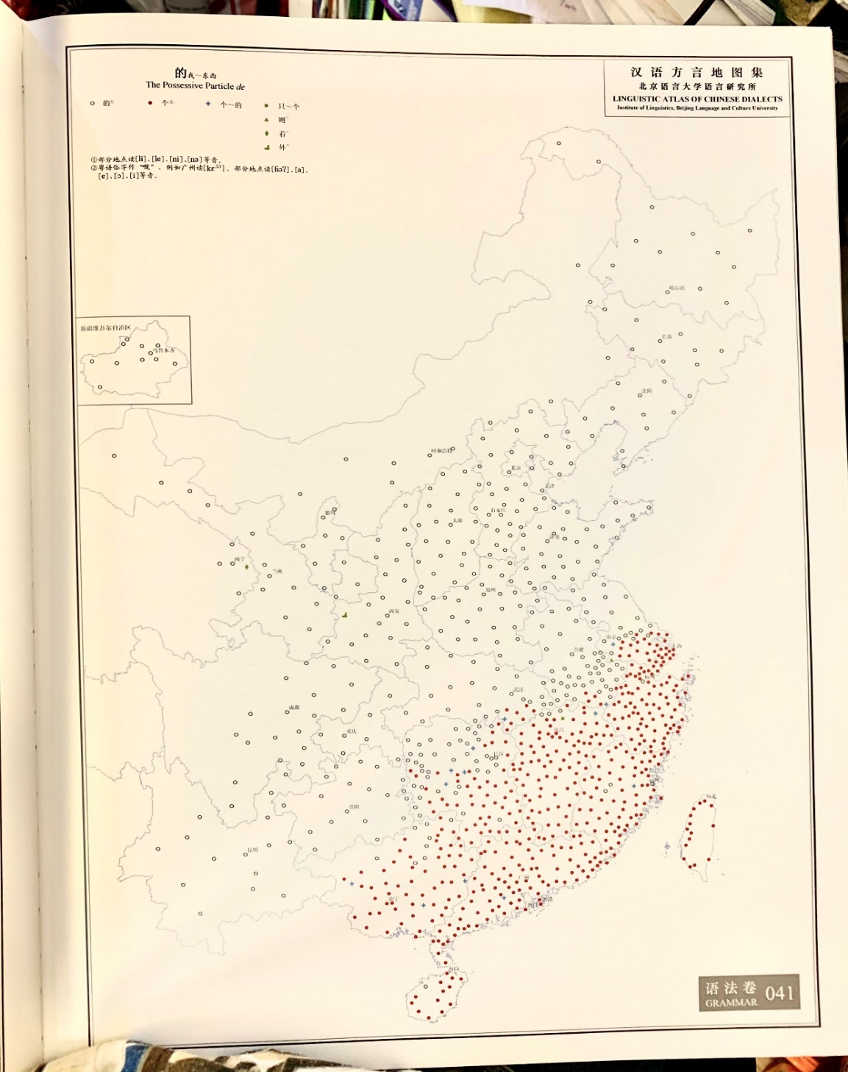
Chinese nominal microvariation: VgeO vs *keoi ge lousi
(?)VgeO vs *keoi ge lousi
(intermediate
isogloss)
Intermediate mainland dialects (Wu, Xiang, Kejia)
Chinese nominalization (de/ge):
Dialect | Past-time clefts (VdeO) | Activity nominals (ta de laoshi)
North (北方話, 東北話) | VdeO | Ta de laoshi
Central/intermediate mainland dialects (Wu, Xiang, Kejia) | (?) VgeO | *keoi ge lousi
South (Cantonese, Taiwanese Min) | *VgeO | *keoi ge lousi

Slide 9
Nominal microvariation (名詞參數)
Chinese adnominalisers (de/ge) are nominal functors (Paul (2015, 2019))
Attributional/modificational markers are relatively low on nominal spine below all the referential elements (possessives, demonstratives, numerals, quantifiers, classifiers):
POSS DEM NUM/Q CL MOD NP
(Cheng and Sybesma (1999, 2015:3); Aoun and Li (2003:267); del Gobbo (2003:42), Sio (2011:129))
張三 (的) 這 三 本 Chomsky 的 書
Zhangsan de zhe san ben Chomsky de shu
‘Zhangsan’s three Chomsky books’
(modified from Saito, Lin, Murasugi (2008:121-122))
張三 (嘅) 呢 三 本 Chomsky 嘅 書
ZS ge ni saam bun Chomsky ge shue
‘Zhangsan’s three Chomsky books’

Slide 10
Chinese nominal domain (Paul (2005, 2012, 2019))
DP
SpecDP D’
D PossP
SpecPossP Poss’
Poss NumP
SpecNumP Num’
Num QP
SpecQP Q’
Q CLP
SpecCLP CL’
CL ModP
SpecModP Mod’
Mod nP
NP
de/ge
Longobardi and Silvestri (2013): POSS as a high nominal functional head
張三嘅三本Chomsky嘅書
張三本Chomsky嘅書
POSS Mod
+D
de/ge
Rubins (1994)

Slide 11
Chinese Activity constructions
Subject-Object Asymmetry (黃 2008; 鄧 2009):
他 當 他 的 老師 (Mandarin)
ta dang ta de laoshi
他 的 老師 當 得 好
ta de laoshi dang de hao
‘He is being a good teacher.’
佢做佢嘅老師 (Cantonese)
keui zou keui ge lousi
*佢 嘅 老師 做 得 好
keui ge lousi zou dak hou
‘He is being a good teacher.’
Light Verb Analysis (黃 2008; 鄧 2009; 2010):
In object position, both de an ge can head Activity nominals (ta de laoshi/keoi ge lousi);
in subject position, de but not *ge is grammatical (ta de laoshi/*keoi ge lousi)
DO + VP
[DO [GP ta de dang laoshi]]
[dang i [GP ta de t i laoshi]]
[DO-P ta dang i [GP ta de t i laoshi]]
[DO-P [GP ta de t i laoshi] j [dang i t j [de hao]]

Slide 12
黃 (2008): Light Verb DO
Influential proposal (黃 (2008)): Light Verb DO (cf Huang (1997), Lin (2001), cf Larson (1989), Dowty (1991), Hale and Keyser (1993, 2002))
DO + Gerund Phrase (GP) nominalized by de and, by extension, ge
他當他的老師/他當他的老師 [DO [GP ta de dang laoshi]]
[dang i [GP ta de t i laoshi]]
[DO-P ta dang i [GP ta de t i laoshi]] (他當他的老師)
[DO-P [GP ta de t i laoshi] j [dang i t j [de hao]] (他的老師當得好)
1) Activity selection (DO + GP denoting Activity event (e.g. 他的當老師))
2) Head movement of the verb (here dang 當) from GP to DO
3) Argument selection in SpecDO (here ta 他 ‘Actor’)
4) Argument deletion and remnant movement of GP to SpecDO (他的t i 老師）
5) New complement (e.g. 得好 denoting extent) added to matrix verb 當

Slide 13
鄧 (2009)/Tang(2011): dialectal nominalization parameter
鄧 (2009, 2010) applies Huang’s Light Verb DO analysis to Cantonese:
DO + Gerund Phrase (GP)
佢嘅老師做得好:
[DO [GP keoi ge zou lousi]]
[zou i [GP keoi de t i lousi]]
[DO-P keoi zou i [GP keoi ge t i lousi]] (佢做佢嘅老師)
[DO-P [GP keoi ge t i lousi] j [zou i t j [dak hou]] (佢嘅老師做得好)
鄧 (2008): Cantonese ge cannot nominalise a clause (keoi *ge zou lousi)
Tang (2011): Cantonese ge is less grammaticalized as Mandarin de i.e. it still retains some of its nominal properties whereas de is more bleached
> Tang’s nominal parameter (鄧 (2009))

Slide 14
Critical appraisal (黃 (2008), 鄧 (2008, 2009)):
Huang’s DO:
他的老師當得好: [DO [GP ta de dang laoshi]]
Ta de laoshi dang de hao [dang i [GP ta de t i laoshi]]
[DO-P ta dang i [GP ta de t i laoshi]]
[DO-P [GP ta de t i laoshi] j [dang i t j [de hao]] (Huang (2008))
1) Clitic position of de (ta-de)- why not nominal head of GP (G)?
2) If de is nominal head, would it not block head movement of Activity verb (here 當dang)?
3) A-selection/deletion seems to violate Theta-criterion (one-to-one correspondence between theta-roles and A-positions (胡建華 (2012, 2016)), and how justify remnant movement of Activity GP to SpecDO?

Slide 15
New formal proposal: alternative solutions
Pace 黃/鄧, Actor and Activity seem to be merged in different A-positions (i.e. Actor and Activity can co-occur in the same utterance):
他 當 他 的 老師 當 得 好
Ta dang ta de laoshi dang de hao
佢 做 佢 嘅 老師 做 得 好
Keoi zou keui ge lousi zou dak hou
‘He does his role as a teacher well.’ (Mandarin/Cantonese)
No need to delete subject argument (Actor) and move Activity nominal
Light verb: following Baker’s UTAH (Projection Principle), arguments are merged in the specifiers of various argument-introducing Light Verb heads (Lin (2001))
If so, there seems to be two distinct Light Verb projections here: DO which introduces Actor (SpecDO) and DONE which introduces Activity (SpecDONE)- no need for A-deletion and remnant movement of GP

Slide 16
DO-DONE Light Verb Complex
Assuming two distinct Light Verb projections (DO + DONE + VP > Actor + Activity + V):
他 當 他 的 老師，我 當 我 的 學生
Ta dang ta de laoshi, wo dang wo de xuesheng
佢 做 佢 嘅 老師，我 做 我 嘅 學生
Keoi zou keoi ge lousi, ngo zou ngo ge hoksaang
‘He does his job in being a teacher, I do mine in being a student.’ (Mandarin/Cantonese)
他 的 老師 當 得 好 / *佢 嘅 老師 做 得 好
Ta de laoshi dang de hao / Keoi ge lousi zou dak ho
‘He acts well in being a teacher.’ (Mandarin/Cantonese)
In subject position, southern *ge is ungrammatical
Modified: ge in SpecDONE is ungrammatical only in the absence of DO

Slide 17
Chinese Activity (Light Verbs)
他 當 他的 老師 當 得 好 (Mandarin)
Ta dang ta de laoshi dang de hao
‘He is being a good teacher.’
佢 做 佢 嘅 老師 做 得 好 (Cantonese)
keoi zou keoi ge lousi zou dak hou
Theta-criterion: one theta-role per argument (胡 2016, cf Chomsky (1981))
DO + DONE + VP
Actor
Activity
[DO-P ta dang i [DONE-P ta de laoshi dang i [VP t i ]]
[DO-P keui zou i [DONE-P keui ge lousi zou i [VP t i ]]
Ta de laoshi (Mandarin)/
*keui ge lousi (Cantonese)
in SpecDONE (Activity) if no Actor is projected in SpecDO

Slide 18
Chinese Activity nouns (ta de laoshi vs *keoi ge lousi)
de (的) vs ge (個):的 < 底 < 者 (phrase-final nominaliser)/個 (classifier)
只道自己的鐧與槍舞得好
‘thinking that he wields his arms and weapons well.’ (隋唐演義)
他的棋子雖然下得極高
‘Although he plays well extremely well…’ (二十年目睹之怪現狀)
貴教師的中國話說得很好
‘You teacher speaks Chinese excellently’ (文明小史，第十三囘)
後面個僧祗對看
‘The monk behind you can only stare.’ (景德傳燈錄，卷八)
用汝個月作麽？
‘What use is your moon?’ (同上)
但只硬把定中間個心
‘But holding the heart in the middle by force…’ (朱子語類）
ge (個) as classifier has count and individualizing function -> ge cannot select Activity NPs

Slide 19
Activity Structure (DO + DONE)
DO-P
SpecDO DO’
DO DONE-P
SpecDONE DONE’
DONE … VP
V’
V
Actor
ta / keoi
Actor (raised
from Activity (SpecDONE))
Activity (headed by de/ge)
Ta de laoshi/
*Keoi ge lousi
With DO, Actor is raised from the Activity nominal
Without DO, de but not *ge can head an Activity nominal

Slide 20
Chinese cleft (是-的) constructions
Chinese cleft constructions (shi (是) + de (的) constructions):
SUBJECT + COP + focus + presupposition + DE
(Lee (2005:133), Paul and Whitman (2008:430), Hole (2011:1710))
COP + VOde / VdeO (Long and Xiao (2009, 2011), Zhan (2012), Long (2013))
VOge / VgeO (李 2016)
It + COP + focus (relativized element) + presupposition (relative clause) (Hedberg (2000:96))
Cleft constructions are copular (Zhan and Traugott (2012, 2017), cf Higgins (1979)).

Slide 21
Chinese copula (是/係) + relative clause (VOde/VOge)
Equational: subject and complement are co-referential
COP + VOde / VOge:
師云：“人人盡有底衣即是。”
僧云：“既是人人盡有底，用被做什摩？
Teacher says, ‘The clothes which everyone has then it is.’ Monk says, ‘As it is clothes which everyone has, why use sheets?’
Paul (2011), Zhang (2013):
-的話dehua conditionals
師指面前狗子云：“明明個，明明個。”
僧便問師：”既是明明個，為個摩頭在裏許？
‘Teacher points at a dog ahead and says, ‘It is bright, bright.’
Monk then asks, ‘If it is bright, why is its head inside?’
In sentence-final position where there is no nominal complement, de/ge can be reanalyzed as sentence-final particle (SFP)
VOde/VOge:

Slide 22
Chinese copula (是/係) + relative clause (VdeO/VgeO)
COP + VdeO / VgeO:
Non-equational/illogical copulas (Yue (1968))
那兩個人是如此如此這般這般使的手段。
‘As for those two people, it was manipulation used in thus thus such such a way’ > ‘It was thus thus so so that those two people manipulated.’ (元雜劇)
娘原是氣惱上起的病
‘As for my mother, it was originally the illness that was contracted by getting angry.’ > ‘it was through anger that mother contracted illness.’ (金瓶梅詞話)
悟空，你是哪世修來的緣法?
‘Wukong, as for you, it is the karma of which life that is obtained?’ > ‘In which life did you obtain karma?’ (Xiyouji 西游記)
须是先说个粗
‘First one must deal with it.’ (朱子語類)
须是把做个题目
‘First one must create topic.’ (同上)
只是寻个是处
‘Only seek a point.’ (同上)
VdeO/*VgeO:
ge retains quantificational meaning and tends to modify either the object noun or the event

Slide 23
Chinese nominal domain in intermediate dialects
(?)VgeO vs *keoi ge lousi
吾 是 昨日 買-個 票 / *吾 個 飯 吃-了 蠻 久
‘It was yesterday that I bought tickets.’ / ‘I ate for quite a long time.’ (Wu)
我 是 前年 到-個 北京/(?)我 個 籃球 打 得 蠻 好
‘It was two years ago that I went to Beijing.’ / ‘I play basketball quite well.’ (Xinhua, Xiang)
我 係 哺日 買-介 票 / *我介步跑得好
‘It was yesterday that I bought tickets Beijing.’ (Kejia)
VgeO (non-referential) vs *keoi ge lousi (referential)
Possessive (+D)

Slide 24
Chinese nominal domain (final)
DP
SpecDP D’
D PossP
SpecPossP Poss’
Poss NumP
SpecNumP Num’
Num QP
SpecQP Q’
Q CLP
SpecCLP CL’
CL ModP
SpecModP Mod’
Mod nP
NP
de/ge
+D
+D pre-empts past-time clefts (*VgeO) and Activity nominals (*keui ge lousi)
de/ge
ge: +count
+count pre-empts past-time clefts (*VgeO)
and Activity nominals (*keui ge lousi)

Slide 25
Conclusions
ge (嘅) and de (的) show discrepancies in past-time clefts (VdeO/VgeO) and Activity nominals (ta de laoshi/keui ge lousi):
classifier ge (個) (+count/individual/delimit) (Bisang and Li (2012), Zhang (2013))
ge is more marked than de <-
Dialect families/areas | Adnominaliser (結構助詞）
North | de (VdeO, ta de laoshi) (-count)
Intermediate (Wu, Xiang, Kejia) | ge (VgeO, *keoi ge lousi) (+count, +/-D)
South (Cantonese, Taiwanese Min) | ge (*VgeO, *keoi ge lousi) (+count, +D)
Degree of nominality:
Construction | Featural make-up
Possessives (ta de laoshi/keoi ge lousi) | POSS (+D)
Relative clauses (VgeO) | Mod (+count, +/-D)
Relative clauses (VdeO) | Mod (-count, +/-D)

